Slide 1
Limited Dependent Variables

Slide 2
Consider the Following Examples
Insurance: Predicting loss amounts of customers
Customers report claims only if it is above the deductible limit
Claim is not made even though a loss may have occurred
Customers never make a claim beyond the coverage amount because it will not be reimbursed
Claim is made, but not to the actual extent of the loss
Retailing: Predicting store demand
Store may be out-of-stock: Sales less than actual demand

Slide 3
Consider the Following Examples
Targeting: Predicting customer response to offers (whether they respond and how much they spend)
Spending is known only for those customers who chose to respond to past offers
Customers who respond to past offers may be characteristically different than those who did not

Slide 4
Truncation, Censoring and Selection
Truncation: Only outcomes in a certain range are recorded
Left truncation: Outcomes below a known threshold are NOT recorded (and you cannot know whether they occurred)
Right truncation: Outcomes higher than a known threshold are NOT recorded (you cannot know whether they occurred)
Censoring: All outcomes are recorded, but values may only be partially known
Left censoring: Exact value of outcome below a threshold is not known, but it is known that value is less than the threshold
Right censoring: Exact value of outcome above a threshold is not known, but it is known that the value is above the threshold
Sample Selection: Outcome is known only for a non-representative subset of the sample

Slide 5
Truncation, Censoring and Selection
Insurance example: Left-truncation with right censoring
Retailing example: Right censoring
Targeting example: Sample selection (spending is not known for customers who do not respond)
Factors influencing customers to respond, also likely to influence customers to spend
E.g., consumers respond only if their need is high enough, which also affects how much they spend

Slide 6
Donation Example
Customers are routinely contacted for a donation
Data available for latest campaign
Donate: Whether customer donated
Gift: Donation amount if customer donated (=0 otherwise)
We want to model how previous donation behavior predicts response to this campaign
RespLastMail: Whether customer responded to last contact mail
WeeksLastResp: Weeks since customer last responded
MailsPerYear: Number of contacts made (mails) per year
PropResponse: Proportion of past contacts that led to response
AverageGift: Average past donation (conditional on donating)

Slide 7
Donation Example
DONATE | GIFT | RESPLASTMAIL | WEEKSLASTRESP | PROPRESPONSE | MAILSPERYEAR | AVERAGEGIFT
0 | 0 | 0 | 143 | 0.3 | 2.5 | 10
0 | 0 | 0 | 65.42857143 | 0.3 | 2.5 | 10
0 | 0 | 1 | 13.14285714 | 0.3 | 2.5 | 10
0 | 0 | 0 | 120.1428571 | 0.3 | 2.5 | 10
1 | 10 | 0 | 103.8571429 | 0.2 | 2.5 | 10
0 | 0 | 0 | 129.1428571 | 0.3 | 2.5 | 10
0 | 0 | 0 | 143 | 0.3 | 2.5 | 10
0 | 0 | 0 | 103.8571429 | 0.5 | 2.5 | 6
0 | 0 | 1 | 13.14285714 | 0.3 | 2.5 | 10
1 | 5 | 0 | 51.28571429 | 0.5 | 2.5 | 5

Slide 8
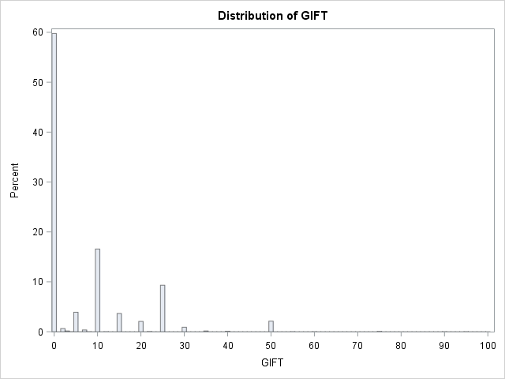
Donation Example
60% of donations is zero – cannot use simple OLS regression (violates assumption about error distribution)

Slide 9
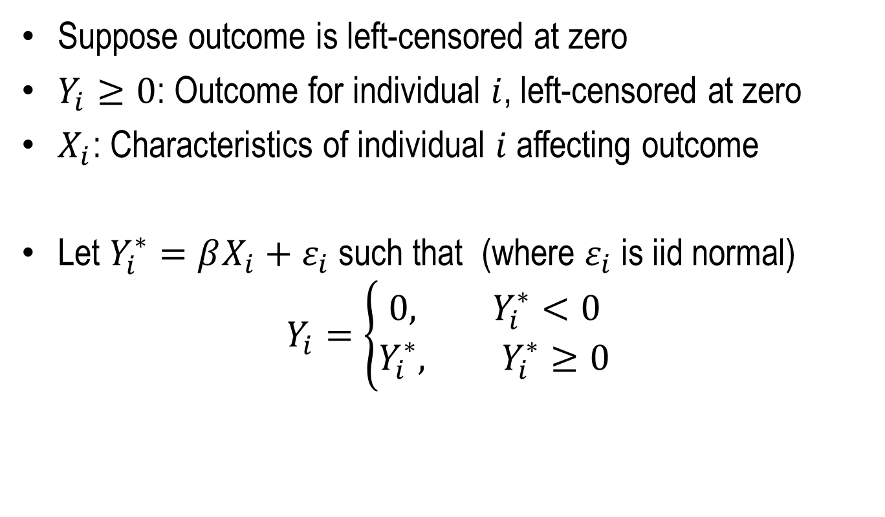
Left Censoring: Tobit Model Formulation
Suppose outcome is left-censored at zero
$Y_{i}≥0$: Outcome for individual $i$, left-censored at zero
$X_{i}$: Characteristics of individual $i$ affecting outcome
Let $Y_{i}^{∗}=βX_{i}+ε_{i}$ such that (where $ε_{i}$ is iid normal)
$$Y_{i}=\left\{\begin{aligned}0, Y_{i}^{∗}<0 \\ &Y_{i}^{∗}, Y_{i}^{∗}≥0\end{aligned}\right.$$

Slide 10
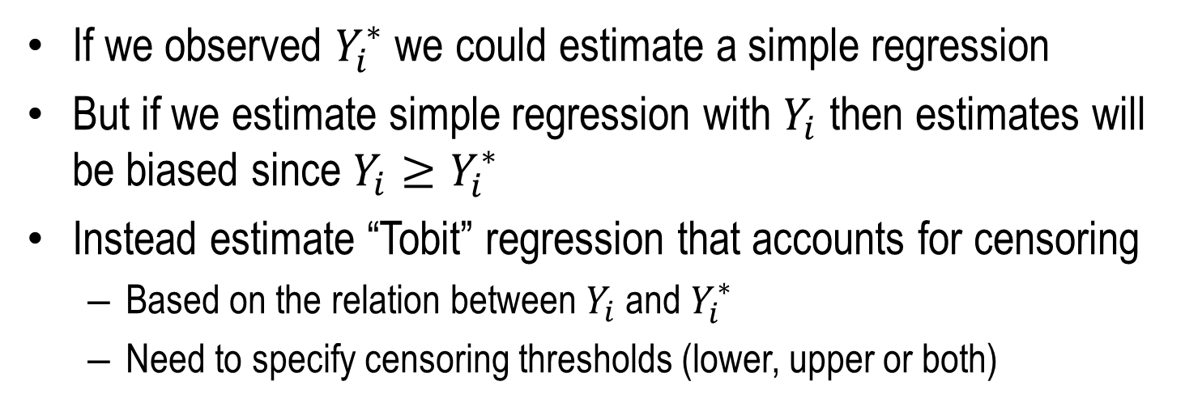
Tobit Model
If we observed $Y_{i}^{∗}$ we could estimate a simple regression
But if we estimate simple regression with $Y_{i}$ then estimates will be biased since $Y_{i}≥Y_{i}^{∗}$
Instead estimate “Tobit” regression that accounts for censoring
Based on the relation between $Y_{i}$ and $Y_{i}^{∗}$
Need to specify censoring thresholds (lower, upper or both)
Variable | Simple OLS | OLS for Y > 0 | Tobit
Intercept | -5.47764** | -1.0186 | -29.912**
RESPLASTMAIL | 1.18912* | -0.2927 | 1.32811
WEEKSLASTRESP | -0.01901** | 0.00758 | -0.1223**
PROPRESPONSE | 12.35516** | 1.7179 | 32.6041**
MAILSPERYEAR | 1.23057** | 0.10143 | 3.10155**
AVERAGEGIFT | 0.29631** | 1.03914** | 0.36965**

Slide 11
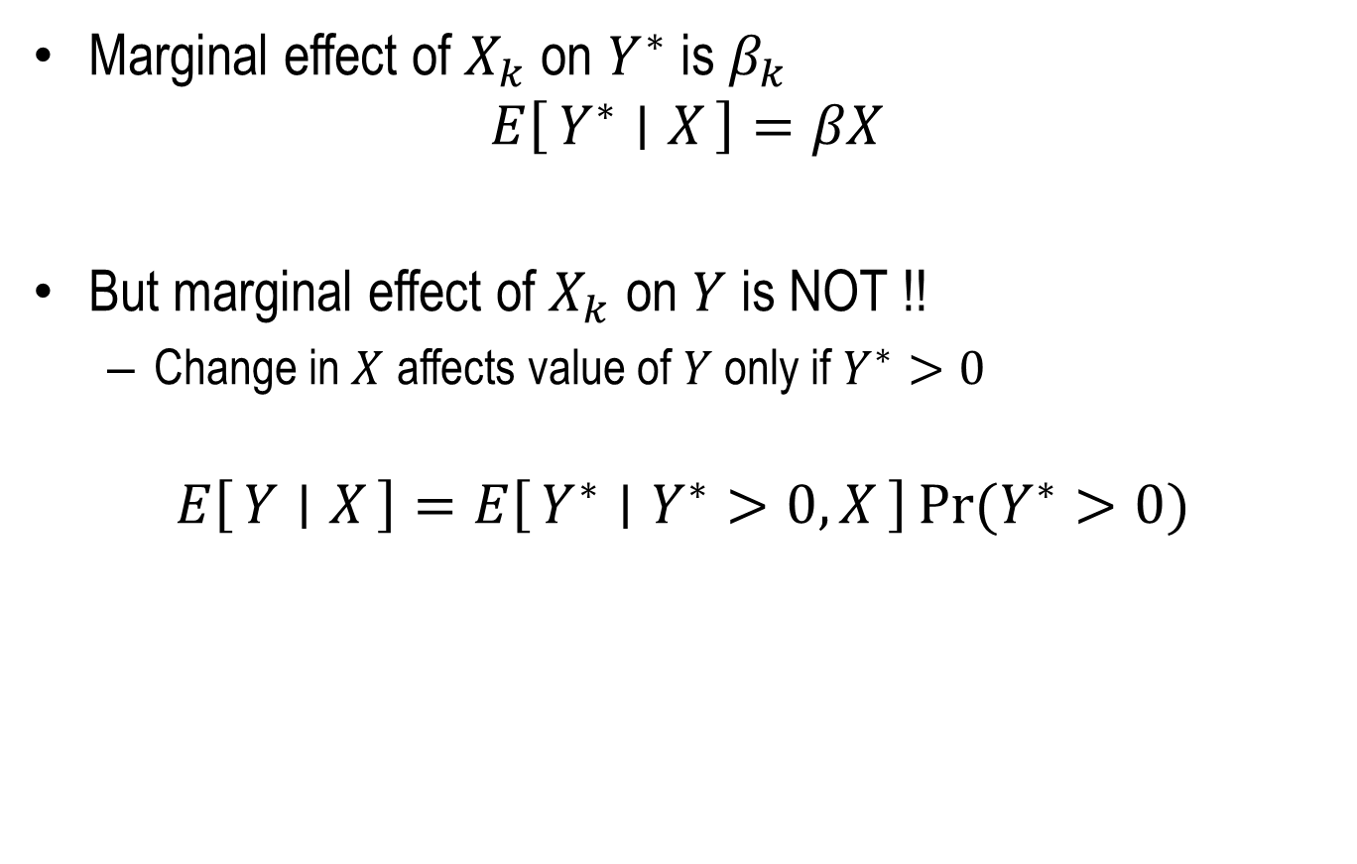
Tobit Model: Interpretation
Marginal effect of $X_{k}$ on $Y^{∗}$ is $β_{k}$
$$E\left[Y^{∗} ∣ X\right]=βX$$
But marginal effect of $X_{k}$ on $Y$ is NOT !!
Change in $X$ affects value of $Y$ only if $Y^{∗}>0$
$$E\left[Y ∣ X\right]=E\left[Y^{∗} ∣ Y^{∗}>0, X\right]\operatorname{Pr}{(Y^{∗}>0)}$$

Slide 12
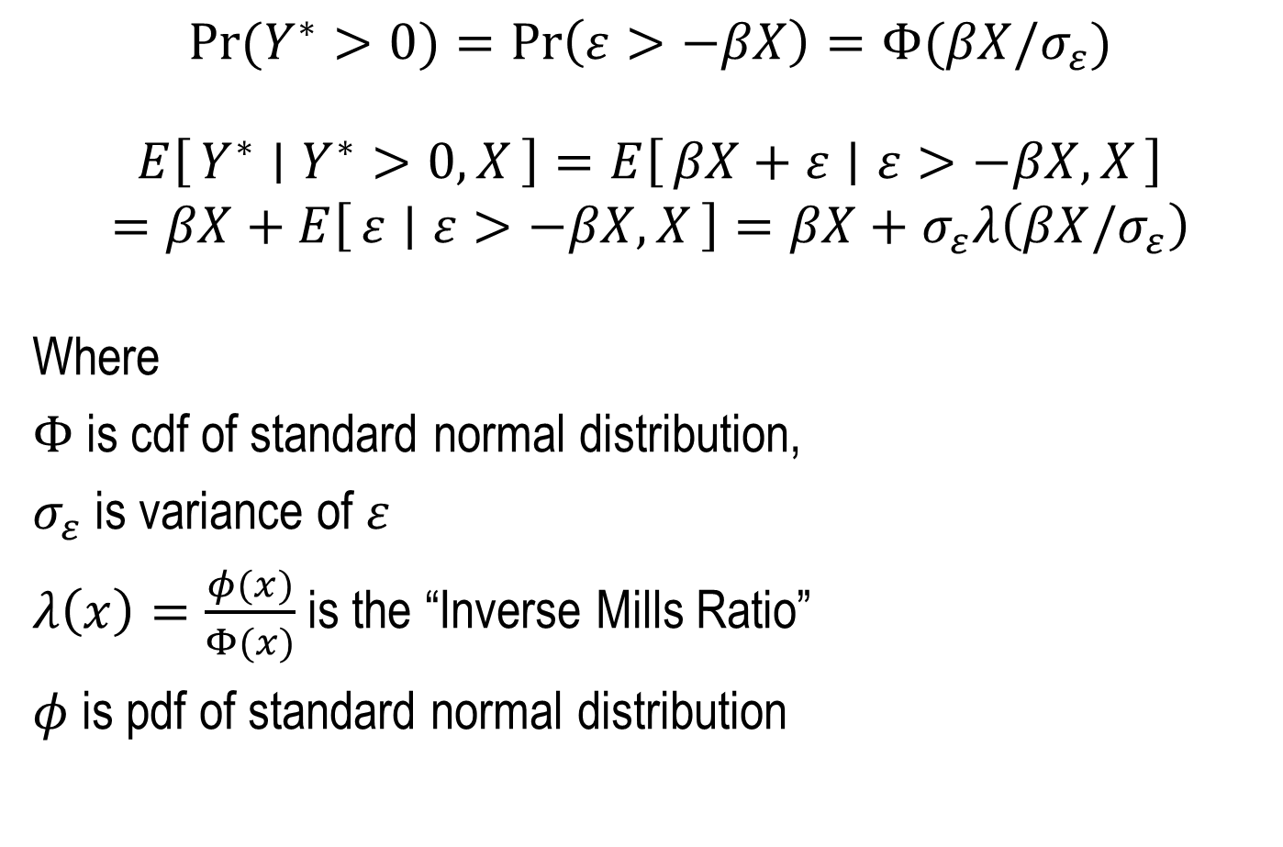
Some Math
$$\operatorname{Pr}{(Y^{∗}>0)}=\operatorname{Pr}\left(ε>−βX\right)=Φ(βX/σ_{ε})$$
$$E\left[Y^{∗} ∣ Y^{∗}>0, X\right]=E\left[βX+ε ∣ ε>−βX,X\right]$$
$$=βX+E\left[ε ∣ ε>−βX,X\right]=βX+σ_{ε}λ\left(βX/σ_{ε}\right)$$
Where
$Φ$ is cdf of standard normal distribution,
$σ_{ε}$ is variance of $ε$
$λ\left(x\right)=\frac{φ(x)}{Φ(x)}$ is the “Inverse Mills Ratio”
$φ$ is pdf of standard normal distribution

Slide 13
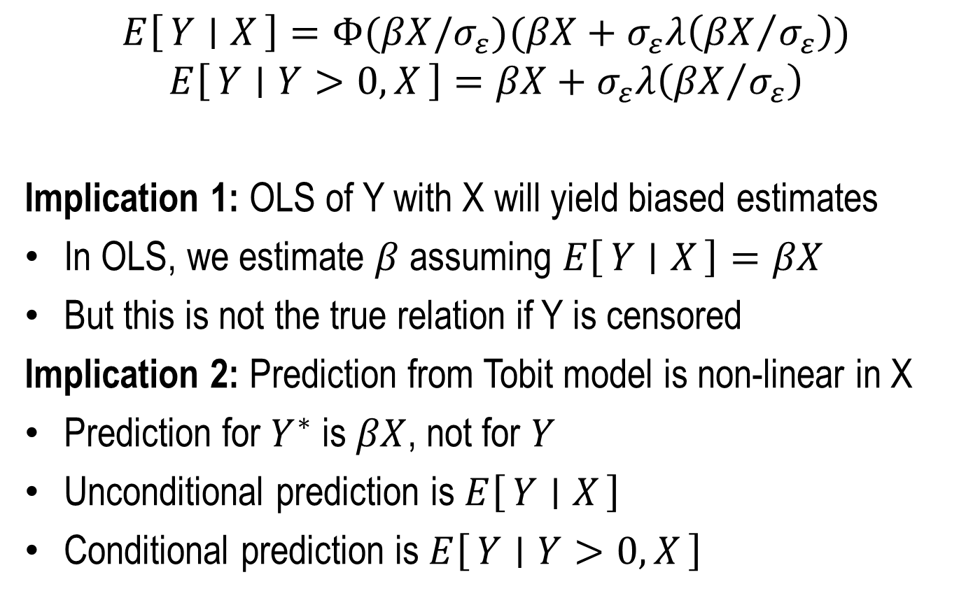
Tobit Model: Interpretation
$$E\left[Y ∣ X\right]=Φ(βX/σ_{ε})(βX+σ_{ε}λ\left({βX}/{σ_{ε}}\right))$$
$$E\left[Y ∣ Y>0,X\right]=βX+σ_{ε}λ\left({βX}/{σ_{ε}}\right)$$
Implication 1: OLS of Y with X will yield biased estimates
In OLS, we estimate $β$ assuming $E\left[Y ∣ X\right]=βX$
But this is not the true relation if Y is censored
Implication 2: Prediction from Tobit model is non-linear in X
Prediction for $Y^{∗}$ is $βX$, not for $Y$
Unconditional prediction is $E\left[Y ∣ X\right]$
Conditional prediction is $E\left[Y ∣ Y>0,X\right]$

Slide 14
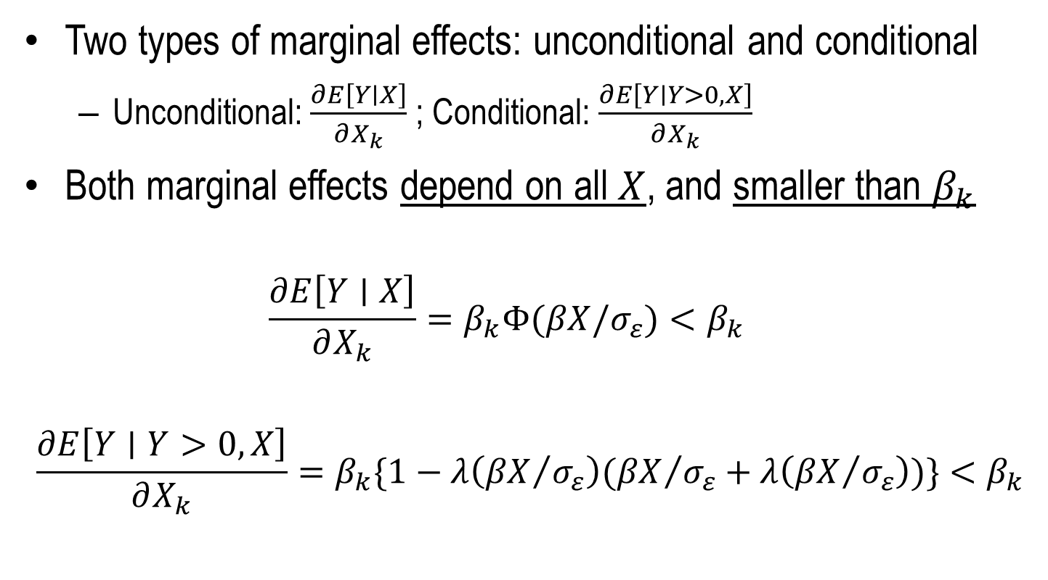
Tobit Model: Marginal Effects
Two types of marginal effects: unconditional and conditional
Unconditional: $\frac{∂E\left[Y∣X\right]}{∂X_{k}}$ ; Conditional: $\frac{∂E\left[Y∣Y>0,X\right]}{∂X_{k}}$
Both marginal effects depend on all $X$, and smaller than $β_{k}$
$$\frac{∂E\left[Y∣X\right]}{∂X_{k}}=β_{k}Φ(βX/σ_{ε})<β_{k}$$
$$\frac{∂E\left[Y∣Y>0,X\right]}{∂X_{k}}=β_{k}\{1−λ\left({βX}/{σ_{ε}}\right)({βX}/{σ_{ε}}+λ\left({βX}/{σ_{ε}}\right))\}<β_{k}$$

Slide 15
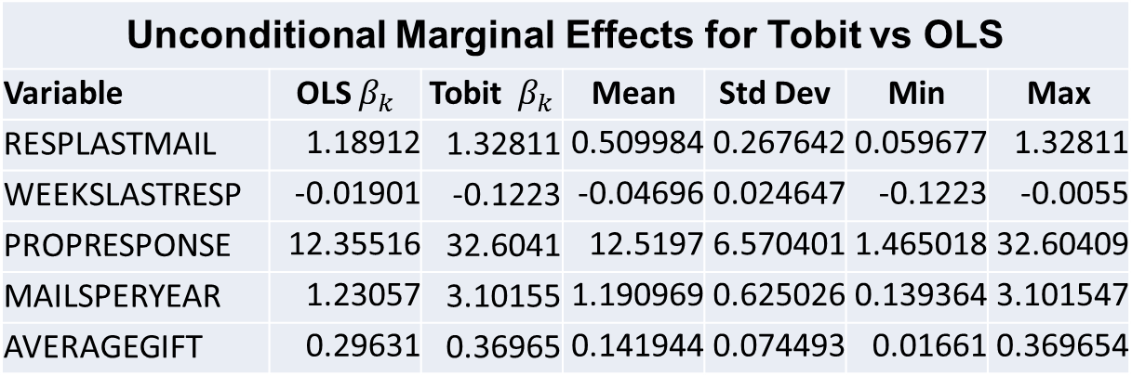
Donation Example: Marginal Effects
Unconditional Marginal Effects for Tobit vs OLS
Variable | OLS $β_{k}$ | Tobit $β_{k}$ | Mean | Std Dev | Min | Max
RESPLASTMAIL | 1.18912 | 1.32811 | 0.509984 | 0.267642 | 0.059677 | 1.32811
WEEKSLASTRESP | -0.01901 | -0.1223 | -0.04696 | 0.024647 | -0.1223 | -0.0055
PROPRESPONSE | 12.35516 | 32.6041 | 12.5197 | 6.570401 | 1.465018 | 32.60409
MAILSPERYEAR | 1.23057 | 3.10155 | 1.190969 | 0.625026 | 0.139364 | 3.101547
AVERAGEGIFT | 0.29631 | 0.36965 | 0.141944 | 0.074493 | 0.01661 | 0.369654
Stats for unconditional marginal effects

Slide 16
Sample Selection: Model Formulation
Two stage model
Step 1 (Selection): Individual decides whether to participate
Probit model for outcome
Step 2 (Response): Individual decides response
Linear model for outcome
Outcome observed conditional on whether selection occurred
Outcome in step 2 is dependent on outcome in step 1
Outcome in step 2 can be influenced by similar or different factors that affected outcome in Step 1

Slide 17
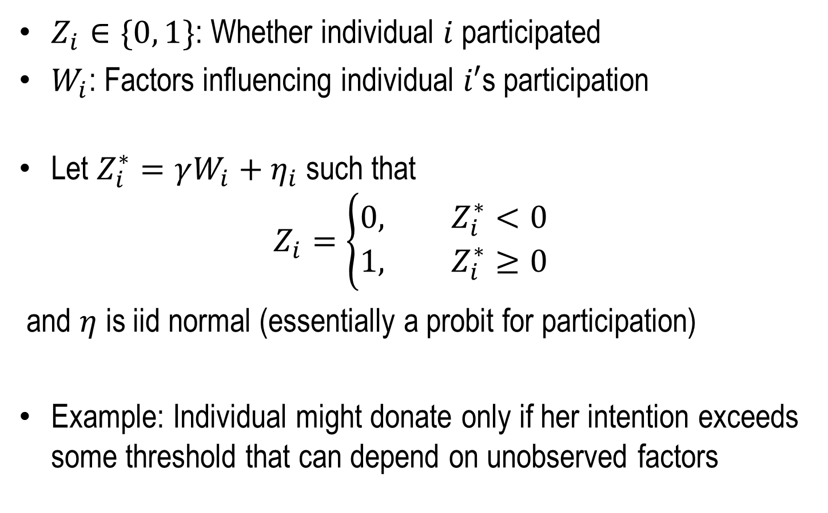
Step 1: Selection Model
$Z_{i}∈\{0, 1\}$: Whether individual $i$participated
$W_{i}$: Factors influencing individual $i′$s participation
Let $Z_{i}^{∗}=γW_{i}+η_{i}$ such that
$$Z_{i}=\left\{\begin{aligned}0, Z_{i}^{∗}<0 \\ &1, Z_{i}^{∗}≥0\end{aligned}\right.$$
and $η$ is iid normal (essentially a probit for participation)
Example: Individual might donate only if her intention exceeds some threshold that can depend on unobserved factors

Slide 18
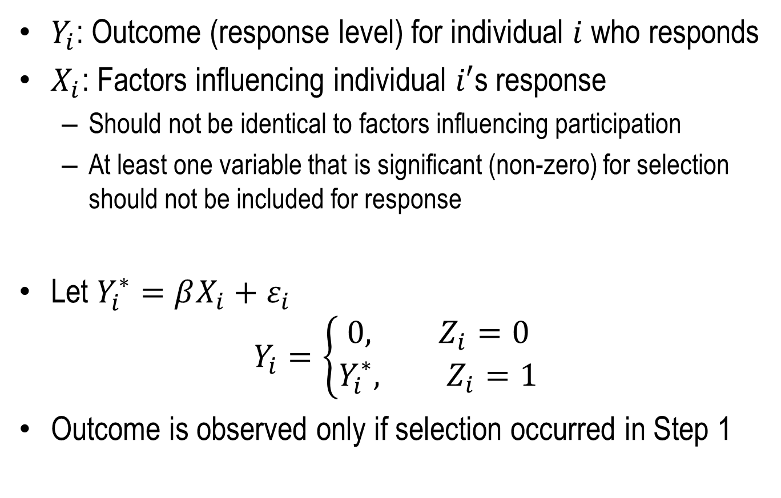
Step 2: Response Model
$Y_{i}$: Outcome (response level) for individual $i$ who responds
$X_{i}$: Factors influencing individual $i′$s response
Should not be identical to factors influencing participation
At least one variable that is significant (non-zero) for selection should not be included for response
Let $Y_{i}^{∗}=βX_{i}+ε_{i}$
$$Y_{i}=\left\{\begin{aligned}0, Z_{i}=0 \\ &Y_{i}^{∗}, Z_{i}=1\end{aligned}\right.$$
Outcome is observed only if selection occurred in Step 1

Slide 19
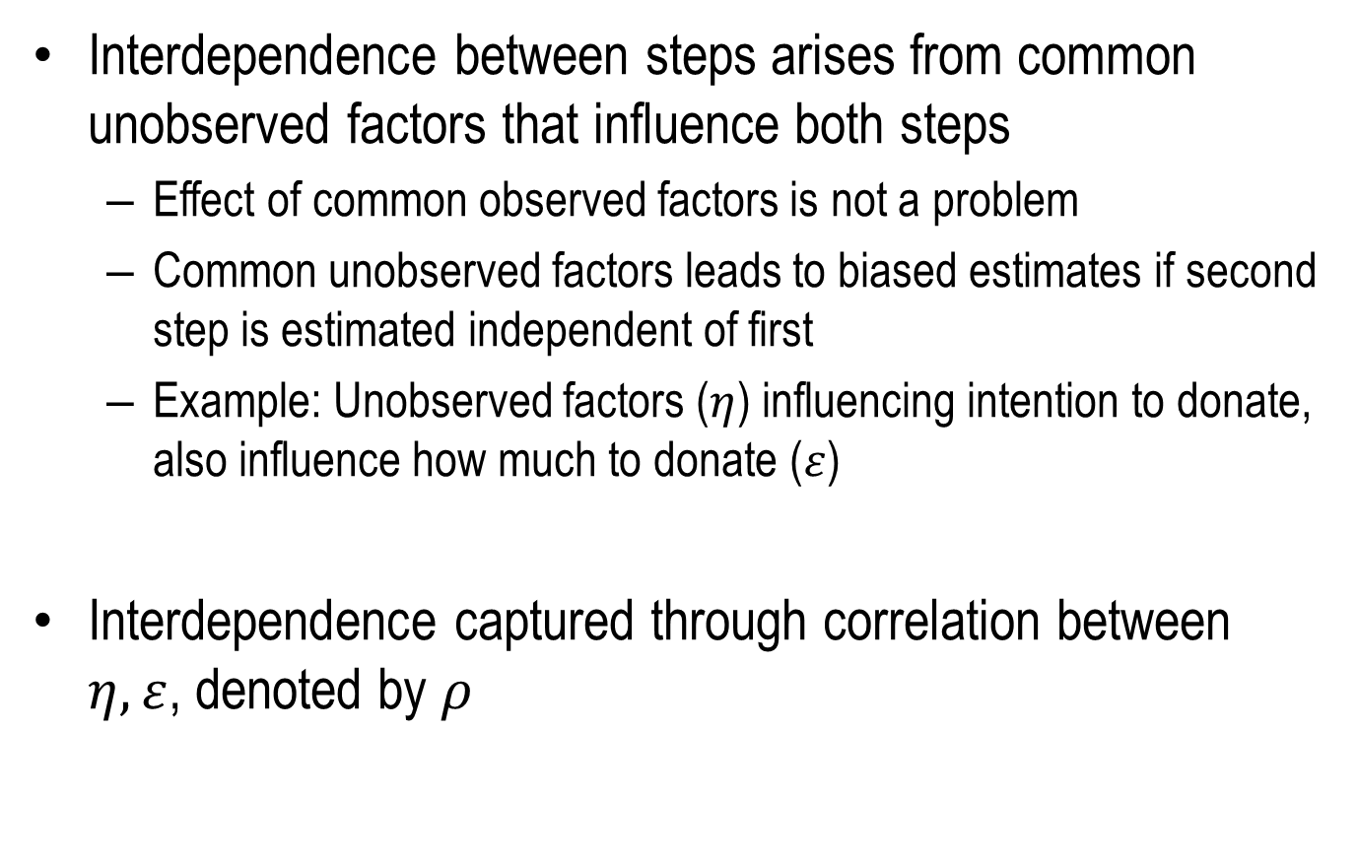
Dependence between Steps
Interdependence between steps arises from common unobserved factors that influence both steps
Effect of common observed factors is not a problem
Common unobserved factors leads to biased estimates if second step is estimated independent of first
Example: Unobserved factors ($η$) influencing intention to donate, also influence how much to donate ($ε$)
Interdependence captured through correlation between $η,ε$, denoted by $ρ$

Slide 20
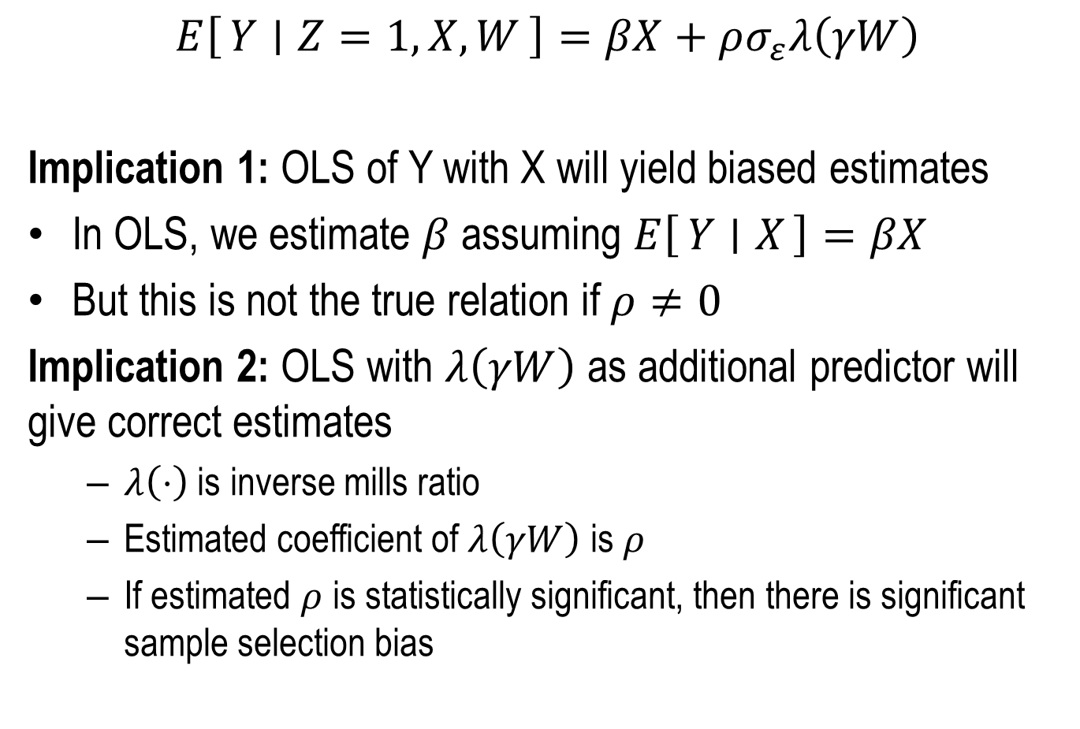
Sample Selection Model
$$E\left[Y ∣ Z=1, X,W\right]=βX+ρσ_{ε}λ\left(γW\right)$$
Implication 1: OLS of Y with X will yield biased estimates
In OLS, we estimate $β$ assuming $E\left[Y ∣ X\right]=βX$
But this is not the true relation if $ρ≠0$
Implication 2: OLS with $λ\left(γW\right)$ as additional predictor will give correct estimates
$λ\left(⋅\right)$ is inverse mills ratio
Estimated coefficient of $λ\left(γW\right)$ is $ρ$
If estimated $ρ$ is statistically significant, then there is significant sample selection bias

Slide 21
Donation Example
Selection – Affected by frequency of mailing, past response rate, whether responded to last contact, time since last response
Response – Affected by average past donation, whether responded to last contact, time since last response
Note: Excludes past response rate

Slide 22
Donation Example
Parameter | Estimate | Std. Err | t Value | Approx Pr > |t|
GIFT.Intercept | 1.466026 | 1.186739 | 1.24 | 0.2167
GIFT.RESPLASTMAIL | -0.408557 | 0.519982 | -0.79 | 0.4320
GIFT.WEEKSLASTRESP | 0.013669 | 0.009249 | 1.48 | 0.1394
GIFT.MAILSPERYEAR | -0.046328 | 0.317776 | -0.15 | 0.8841
GIFT.AVERAGEGIFT | 1.040350 | 0.011960 | 86.99 | <.0001
_Sigma.GIFT | 7.673412 | 0.165296 | 46.42 | <.0001
DONATE.Intercept | -1.300604 | 0.120874 | -10.76 | <.0001
DONATE.RESPLASTMAIL | 0.140524 | 0.058629 | 2.40 | 0.0165
DONATE.WEEKSLASTRESP | -0.004440 | 0.000736 | -6.03 | <.0001
DONATE.PROPRESPONSE | 1.784490 | 0.116311 | 15.34 | <.0001
DONATE.MAILSPERYEAR | 0.168153 | 0.033853 | 4.97 | <.0001
_Rho | -0.214055 | 0.096502 | -2.22 | 0.0265

Slide 23

Model Prediction
$$E\left[Y ∣ Z=1, X,W\right]=βX+ρσ_{ε}λ\left(γW\right)$$
$$E\left[Y ∣ , X,W\right]=Φ(γW)(βX+ρσ_{ε}λ\left(γW\right))$$
Non-linear model => marginal effects depend on value of all X

